Slide 1
Wrapping up
How do the images relate to what we have done in the theme ‘Working Abroad’?

Slide 2
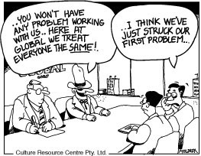

Slide 4
Low- and High-Context Cultures
Individualistic, logical, task-oriented;
Most cultural knowledge explicit and conscious through diverse, discrete, short-term relationships.
Collectivist, intuitive and relationship-oriented;
Most cultural knowlege implicit through myriad of tightly connected, long-term relationships

Slide 5
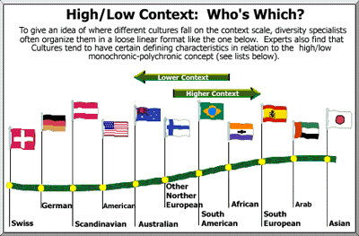
Low context High context
culture culture

Slide 6
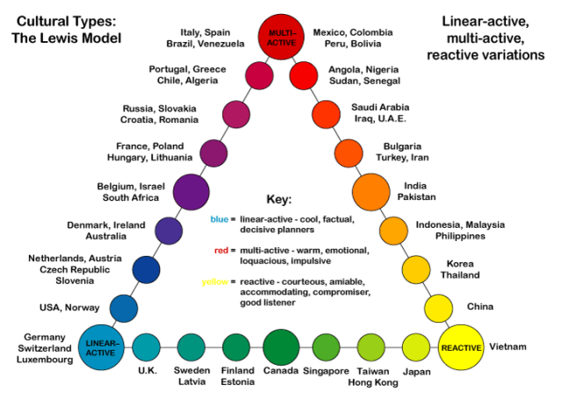

Slide 7
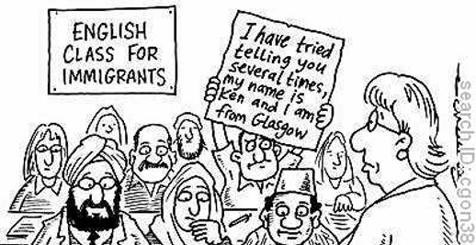

Slide 9
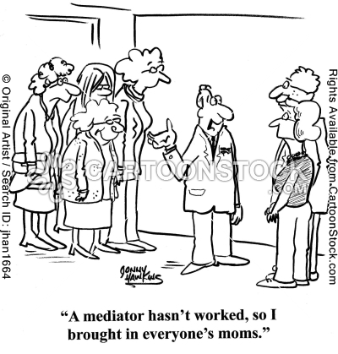

Slide 11
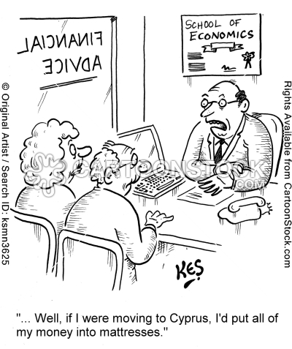

Slide 12
